Slide 1

Undergraduate Research Opportunities Program
Dr. Ramachandra Reddy Sir

Slide 2

Faculty:
Dr. Ramachandra Reddy
Crew of the Project:
AP19110010174 - Boyapati Sai Venkat
AP19110010192 - Konakanchi Subrahmanyam
AP19110010168 - Maddirala Sai Karthik

Slide 3


Topic:
An Analysis of House Price Prediction Using Ensemble Learning Algorithms.
UROP

Slide 4


Key Points

Slide 5
Key Points
Introduction
Dataset Description
Proposed Methodology
Conclusion
Related Works
Data Pre
Processing
Result Analysis
References

Slide 6



Introduction
1
In today's society, the real estate market is constantly a hot topic. People are responsible when it comes to spending and economic approaches when currently looking for a new property.
The real estate market is rapidly growing due to the growth of the economy. Because the price of housing is controlled by emerging markets and a variety of other factors. There are many factors that influence the price of homes.
The main purpose of the project is to forecast home price volatility to determine the best methodology for predicting house prices with less inappropriate data through the use of appropriate algorithms. This estimate is consistent with house prices for non homeowners based on their financial resources and objectives.

Slide 7

Related
Works
Basing on the previous work studies.

Slide 8
Related Works
Authors: Park B. and Bae J K, 2015; and Glaeser E L and Nathanson C G, 2017.
The data provided play a part in determining the best future prediction model.
The price of a property might fluctuate by location, area, amenities, and other characteristics, and researchers have been trying to find the best possible predictive model to forecast that price over the past decade.
Authors: Rajan U, Seru A, and Vig V, 2015
Providing accurate house price estimates is crucial. Multiple factors influence housing prices, including time and space, house age, surrounding conditions, communities, transportation, and so on.
Authors: Bork L. & Moller S,2015.
Existing forecasting models are often single predictors, i.e., the prediction is made using only one forecasting model. When datasets are noisy, this model's prediction accuracy is really not strong sufficient.
To find the best algorithms for identifying housing market movements, researchers analyzed previous rates of growth or house price indices, which are usually computed from a nationwide average house price

Slide 9


Ensemble Learning
In this topic, we use ensemble learning to forecast house prices. The ensemble learning technique is now thought to be an outstanding prediction tool algorithm. Ensemble learning reduces prediction error by reducing the various factors of the base classifiers. The stability of the basic classifiers determines the overall model's performance. It doesn't focus on any specific occurrences in the training data set because the likelihood of each sample being picked is the same. Ensemble learning performs exceptionally well in prediction, classification, and regression tasks. Ensemble learning beats the basic learner in terms of generalization and prediction accuracy, according to the findings. It also indicates that the proposed methodology is appropriate to property price forecasts and has some pragmatic and referential value.

Slide 10

Best Outcome of Related Works
Ensemble Learning
Ensemble learning is now regarded to be an outstanding prediction tool algorithm. Ensemble learning generalization performance can be enhanced by combining basic learners.
By reducing the dispersion of the base classifiers, ensemble learning improves prediction error. The stability of the basic classifiers determines the overall model's performance. Ensemble the learning accuracy of an instrument well in prediction, classification, and regression tasks.
To estimate the price of real estate, an ensemble learning algorithm model was being used, and the results have been compared to a single decision tree classifier. Ensemble learning beats the basic learner in terms of adaptability and prediction accuracy, according to the findings.
It also shows that the proposed model is applicable to predicting property prices and that it has considerable practical and reference value.

Slide 11

Proposed Methodology
Methods Used

Slide 12
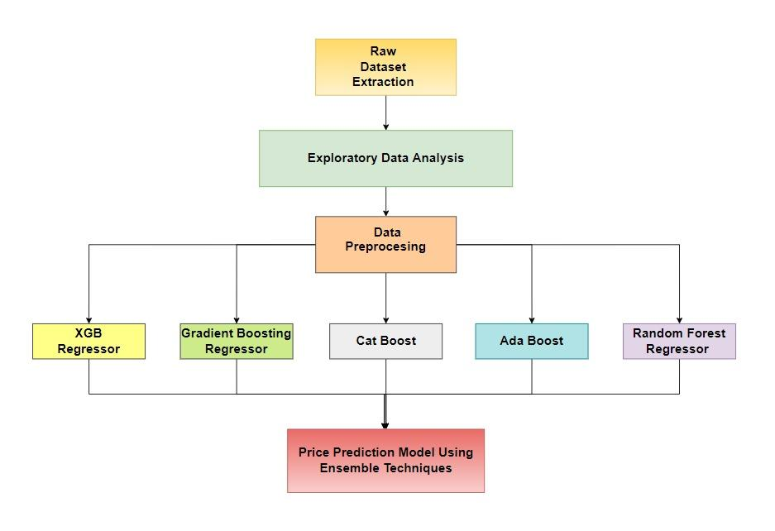
Proposed Methods

Slide 13



Regression
Linear Regression
KNN
Random Forest
SVM
Gradient Boost
XGBoost
ADA Boost
CAT Boost

Slide 14

K-Nearest Neighbour
Linear Regression
Support Vector Machine (SVM)
Random Forest
k-means Clustering is an unsupervised iterative learning process in which n observations are divided into k clusters, with each observation belonging to the cluster mean that is closest to it.​ It can be used for both classification and regression predictive problems. It uses ‘feature similarity’ for predicting the values. The data point is classified into a given category with the help of a training set based on similarity.
This model uses statistical methods to determine the relationship between two or more features present in the dataset. The relation between the dependent and independent is computed using the function containing the least squares. As a general rule, linear regression equations are as follows: y = α +β1x1 +β2x2 +...+βnxn +ε
SVM (Support Vector Machines) are supervised machine learning algorithms used for classification and regression analysis.​ The technique works by constructing models that allocate fresh samples and data to one of many categories, each of which is clearly distinguished from the others by a gap.​
It works by creating a large number of decision trees from random data sets and then repeatedly training a model on them for near-perfect results.​ Finally, all of the decision tree outcomes are merged to get the most suited result that occurs most frequently in the output.​

Slide 15

CAT Boost
Gradient Boost
XGBoost
ADA Boost
In boosting, multiple weak models are sequentially integrated and a strong competitive predictor is constructed using greedy search. Additions of new functions are added until and unless the chosen loss function can no longer be minimized.
We're utilizing gradient boost for regression when we use it to predict a continuous value. This is distinct from the use of linear regression.
XGBoost is a gradient boosting method that minimizes over fittings and bias by combining parallel processing, tree pruning, missing value management and regularization. XGBoost uses ensemble learning to forecast a single value, which takes into account a set of models known as base learners.
AdaBoost is a regression approach that uses both "simple" and "weak" classifiers to create a "strong" classifier. The algorithm fits a regression to the initial data set, then fits multiple copies of the regression to the alike data set, weighing each instance according to the current prediction's error.

Slide 16
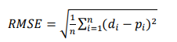
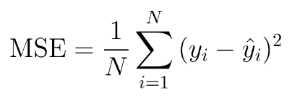
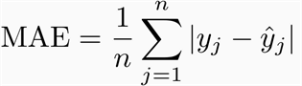
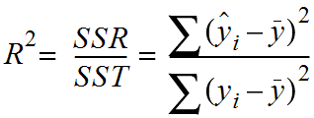
Performance Measures
Root Mean Square Error
Mean Square Error
Mean Absolute Error
R2
The RMSE is used to compute the expected performance by taking into account each data's prediction error.
Most people are familiar with and regularly use Mean Square Error (MSE), which is often taught in Machine which is frequently taught in Machine Learning courses.MSE can’t contain a negative value as the sum is applied to a squared number.
The average or mean of the absolute error is termed MAE.
In order to analyze a model's performance, the R2 score is calculated. As a result, it is used as a tool to determine how well a model is trained to produce accurate results.

Slide 17

Dataset Description
California Dataset.
King County Dataset.

Slide 18

California Dataset Description
The current house price dataset was extracted from Kaggle.
The dataset chosen has test and train data in which the training dataset consists of 80 independent variables and 1 target variable with 1460 rows the test data consists of 80 dependent variables with 1459 rows.
The target variable from the train data has been removed and assigned to another variable in order to combine train and test data.
The dataset consists of some redundant attributes which are removed in the next phase to avoid data disturbance. Important parameters that hugely affect the price of a house, GrLivArea, OverallQual, YearBuilt, YearRemodAdd, and GarageArea are thoroughly examined in the dataset.

Slide 19

King County Dataset Description
The second dataset based on King County Housing is a whole single dataset.
The dataset consists of 21 columns some of which are redundant and some of which are unnecessary.
The target feature is the price column which is also termed the dependent variable. All the other independent features will be used to predict house prices.

Slide 20

Result Analysis

Slide 21
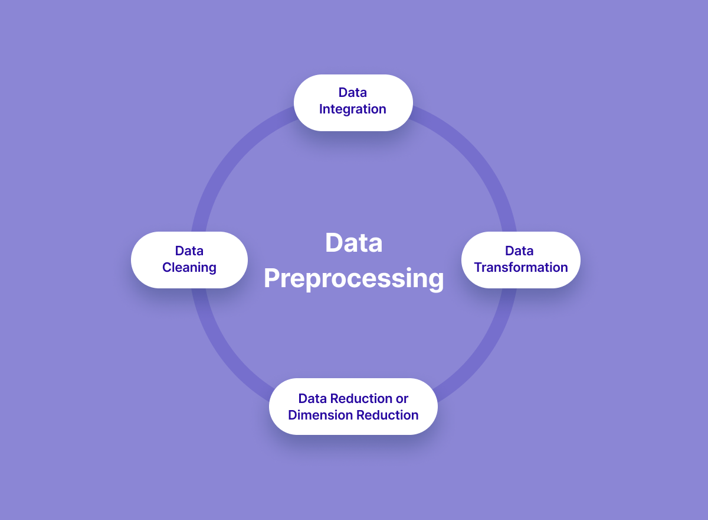
Data Pre Processing

Slide 22
California Housing Dataset
On the basis of the analysis, it is observed that the dataset contains numerical as well as categorical attributes. On further analysis, it is found that the dataset contains null and missing values. During the analysis, some of the attributes were found to contain outliers and therefore skewness.
Correlation analysis was performed between different features in the dataset to see how well the features are correlated with each other. We then dropped the unnecessary features(columns) from the dataset which when present can affect the prediction model resulting in a prediction that is less accurate.
The next process is to handle the missing and incorrect values. For this process, we first plotted a heatmap to check which columns(features) have missing values. We then replaced the incorrect values with “NAN”

Slide 23
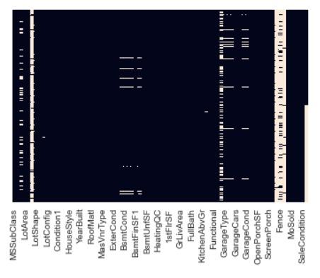
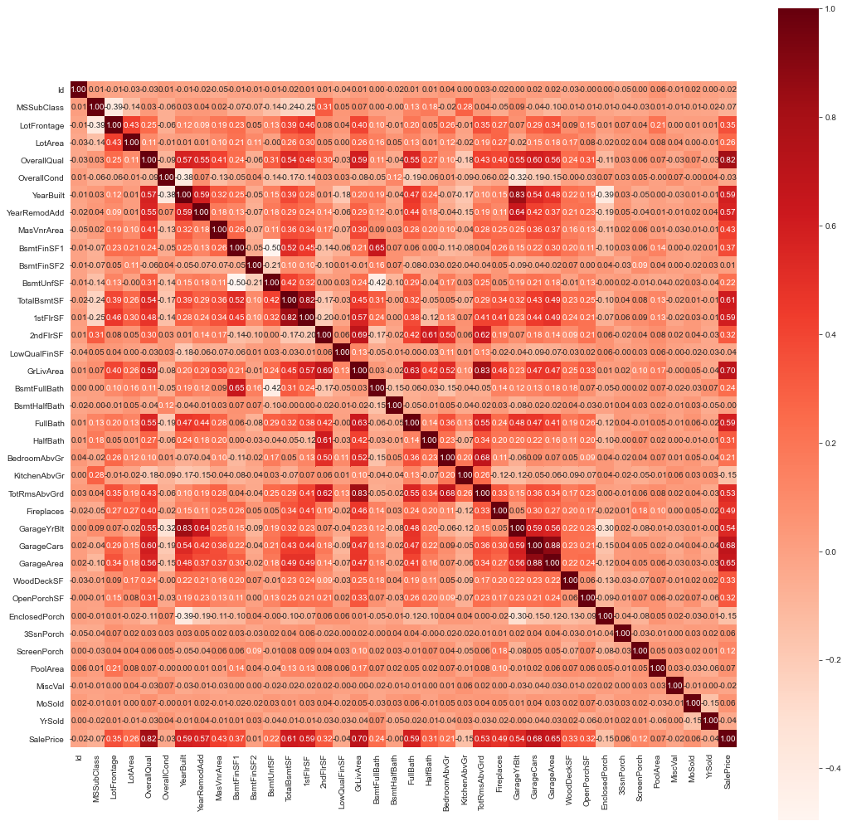
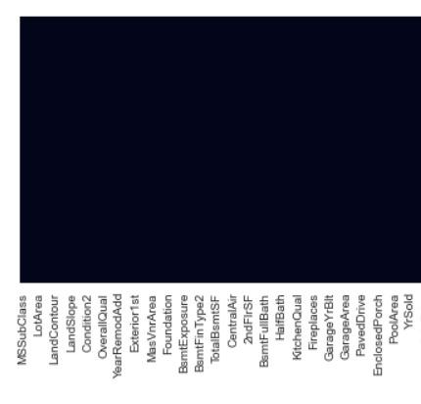
Before Handling Missing Values:
Correlation Analysis:
After Handling Missing Values:

Slide 24
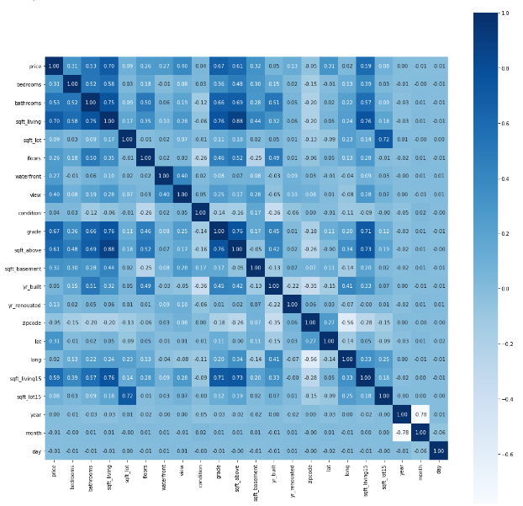
King County Housing Dataset
The King County Dataset is observed to have zero missing values on initial observation. Some unnecessary column features like “id” are then dropped from the dataset. It is found that there are some redundant columns present in the dataset. We first expanded the date feature into 3 separate columns, namely day, month, and year. The year is the only column that is sufficient for our analysis. Therefore, the other two columns are then dropped from the dataset.
The next thing is to remove the redundant column features. So, we used the columns “yr_renovated”, “yr_built” and “year” to add a new column “Age” that determines the age of the house. After this computation, all the three features describing the year renovated, year built, and year are then dropped.
Correlation Analysis:

Slide 25

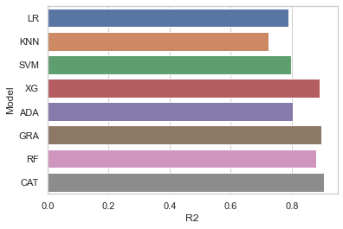
ALGO | RMSE | MSE | MAE | R2
LR | 0.071 | 0.005 | 0.039 | 0.788
KNN | 0.082 | 0.007 | 0.057 | 0.722
SVM | 0.07 | 0.005 | 0.052 | 0.798
XGB | 0.051 | 0.003 | 0.033 | 0.891
ADA | 0.069 | 0.005 | 0.052 | 0.804
GRAD | 0.05 | 0.002 | 0.034 | 0.896
RF | 0.054 | 0.003 | 0.037 | 0.88
CAT | 0.048 | 0.002 | 0.033 | 0.903
California Data Set

Slide 26
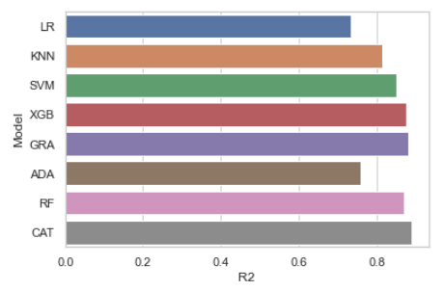
ALGO | RMSE | MSE | MAE | R2
LR | 0.5037 | 0.2537 | 0.3873 | 0.7463
KNN | 0.4182 | 0.1749 | 0.3004 | 0.8251
SVM | 0.3826 | 0.1464 | 0.2712 | 0.8536
XGB | 0.3443 | 0.1186 | 0.2362 | 0.8814
ADA | 0.4901 | 0.2402 | 0.375 | 0.7598
GRAD | 0.3323 | 0.1105 | 0.2315 | 0.8895
RF | 0.3499 | 0.1225 | 0.2414 | 0.8775
CAT | 0.3237 | 0.1048 | 0.2221 | 0.8952
King County Data Set

Slide 27


Conclusion
House Price Prediction System

Slide 28
After applying the machine learning techniques (Linear regression, KNN, SVM) and ensemble techniques (Xgb regressor, Adaboost, Gradient Boosted regressor, Random Forest, Catboost ) ensemble learning techniques are giving the best result for both California and king county datasets.
In ensemble learning techniques Catboost is giving the best result.
RMSE, MSE, MAE, and R2 are the four factors that are considered in determining the accuracy of each of the models. The dataset used here is a publicly available dataset based on California Housing. The same can be extended to predict House Prices and Rental Prices across different locations.

Slide 29
References
"

Slide 30
References
Bork L. & Moller S., 2015. Forecasting house prices in the 50 states using Dynamic Model Averaging and Dynamic Model Selection. International Journal of Forecasting, 31(1), pp.63–78.
Park, B., & Bae, J. K. (2015). Using machine learning algorithms for housing price prediction: The case of Fairfax County, Virginia housing data. Expert Systems with Applications, 42(6), 2928-2934.
Plakandaras, V., Gupta, R., Gogas, P., & Papadimitriou, T. (2015). Forecasting the US real house price index. Economic Modeling, 45, 259-267.
Bin She and Haibin Shen, "An intelligent sensor ensemble learning method based on Bagging-SVM [J]", Sensor and microsystem, vol. 35, no. 2, pp. 26-28, 2016.
Julakha Jahan Jui, M. M. Imran Molla, Bifta Sama Bari, Mamunur Rashid, Md Jahid Hasan, Embracing Industry 4.0, vol. 678, pp. 205, 2020.

Slide 31
Shanshan Sun, "Real estate price prediction based on data mining [J]", Modern electronic technology, vol. 40, no. 5, pp. 126-129, 2017.
Xiufang Yuan, Bochuan Zheng, Weichao Jiao, et al., "Commercial housing price prediction in Shanghai-based on SVM [J]", Gansu science journal, vol. 28, no. 1, pp. 25-28, 2016.
Park B. and Bae J K. Using machine learning algorithms for housing price prediction. Expert Systems with Applications, 42: 2928 – 2934, 2015.
Glaeser E L and Nathanson C G. An extrapolative model of house price dynamics. Journal of Financial Economics, 2017.
Rajan U, Seru A, and Vig V. The failure of models that predict failure: Distance, incentives, and defaults. Journal of Financial Economics, 115: 237 – 260, 2015.

Slide 32
Hope You Like It !!

Slide 33

Thank You !
Group -4

